Slide 1
Randomized algorithms 2 Bloom filters, string matching
CS240 Spring 2024
Rui Fan

Slide 2

Approximate sets
A Bloom filter is a data structure that can implement a set.
It only keeps track of which keys are present, not any values associated to keys.
It supports insert and find operations.
It doesn’t support delete operations.
Bloom filters use less memory than hash tables or other ways of implementing sets.
However, Bloom filters are approximate.
It can produce false positives: it says an element is present even though it’s not.
We can bound the probability of false positives.
But it doesn’t produce false negatives: if it says an element isn’t present, then it’s not.

Slide 3

Bloom filter applications
Suppose we have a big database, and querying it to check if an item is present is expensive.
We store the set of items in the database using a Bloom filter.
This tells us whether an item is in database or not.
If filter says an item’s not present, it’s definitely not in the database.
So no need to do an expensive query.
If filter says an item is present, then either item is present, or there’s false positive.
When we query the database, there’s a small probability we waste time querying for a nonexistent item.
Overall we save time by checking Bloom filter first before querying database.

Slide 4

Bloom filter applications
Consider a P2P network, where each node stores some files.
If you want to get a file, you need to know which nodes have it.
Keeping a list of all items stored at each node is too expensive.
Instead, for every other node, keep a Bloom filter of its files.
If filter says no for a node, it definitely doesn’t have the file.
If filter says yes, then either node has the file, or there’s false positive and we make a useless request.
Overall we save space, and also won’t waste much communication because we rarely make useless requests.

Slide 5
Bloom filters
A Bloom filter consists of
An array A of size m, initially all 0’s.
k independent hash functions h₁,...,h_{k}, each mapping from keys to {1,...,m}.
To store key x
Set A[h₁(x)], A[h₂(x)], ..., A[h_{k}(x)] all to 1.
Some locations can get set to 1 multiple times; that’s fine.
To check if key x is in the set
Read array locations A[h₁(x)], A[h₂(x)], ..., A[h_{k}(x)].
If all the values are 1, output “x is in set”.
Otherwise output “x is not in set”.
x₁
x₂
0
0
0
0
0
1
1
1
0
0
0
0
0
0
0
1
1
A Bloom filter with k=3 hash functions storing 2 items.

Slide 6
Correctness
Let’s look at the correctness of the search function.
If search for x returns no, then at least one of A[h₁(x)],..., A[h_{k}(x)] equals 0.
So x cannot be in the set, because if x had been inserted into the set, then we would have A[h₁(x)]=...=A[h_{k}(x)]=1.
So there are no false negatives.
If search for x returns yes, then A[h₁(x)]=...=A[h_{k}(x)]=1.
So either x was inserted into the set.
Or we inserted some keys that hashed to the same k locations as x.
So it looks as if x was inserted, even though it wasn’t.
This is a false positive. We’ll bound the probability this happens.
x₁
x₂
x₃
0
0
0
0
1
1
1
1
0
0
0
0
0
0
0
0
1

Slide 7
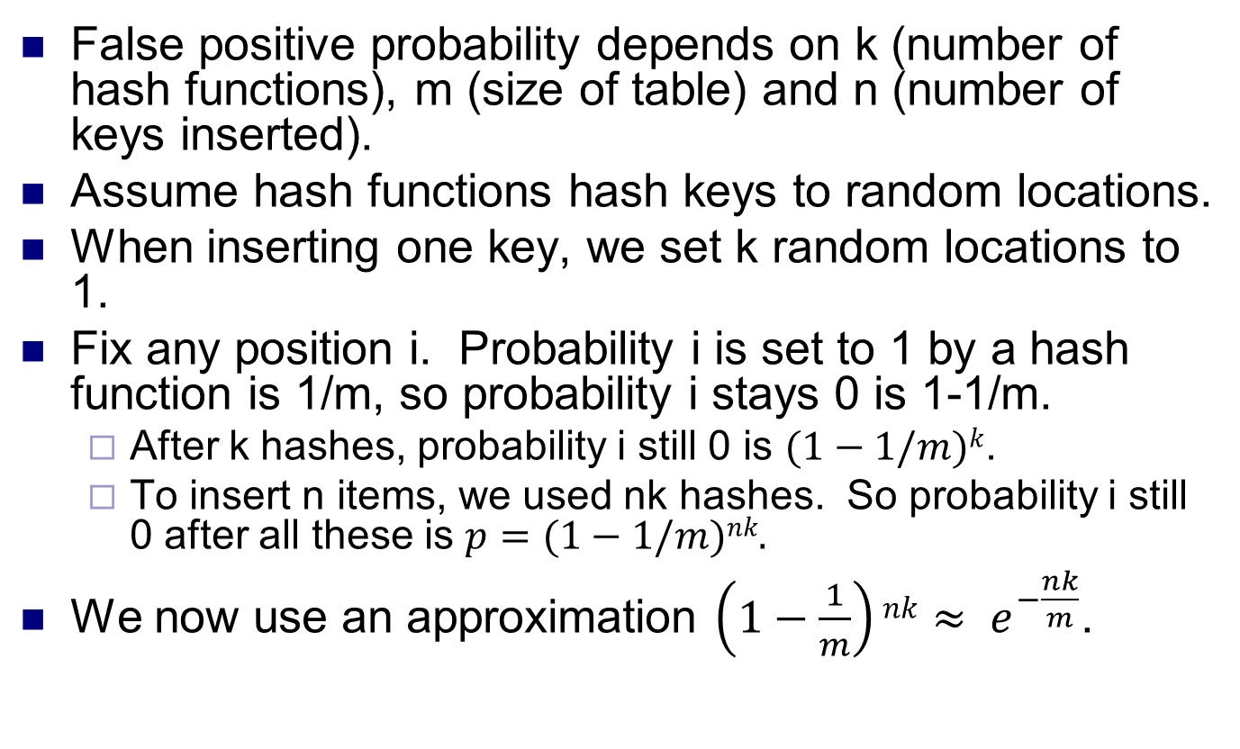
False positive probability 1
False positive probability depends on k (number of hash functions), m (size of table) and n (number of keys inserted).
Assume hash functions hash keys to random locations.
When inserting one key, we set k random locations to 1.
Fix any position i. Probability i is set to 1 by a hash function is 1/m, so probability i stays 0 is 1-1/m.
After k hashes, probability i still 0 is $(1−1/m)k$.
To insert n items, we used nk hashes. So probability i still 0 after all these is $p=(1−1/m)nk.$
We now use an approximation $\left(1−\frac{1}{m}\right)nk≈ e^{−\frac{nk}{m}}$.

Slide 8
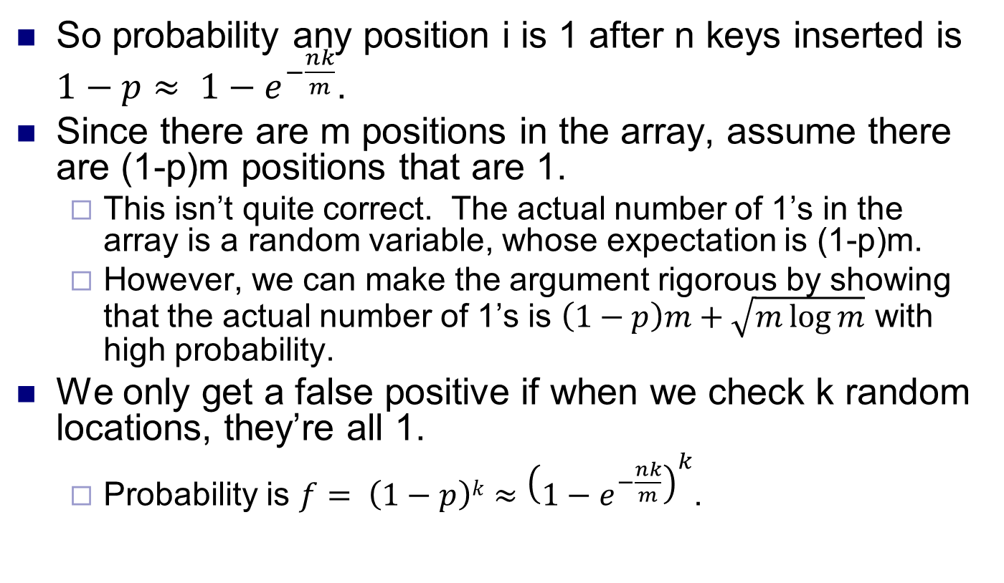
False positive probability 2
So probability any position i is 1 after n keys inserted is $1−p≈ 1−e^{−\frac{nk}{m}}$.
Since there are m positions in the array, assume there are (1-p)m positions that are 1.
This isn’t quite correct. The actual number of 1’s in the array is a random variable, whose expectation is (1-p)m.
However, we can make the argument rigorous by showing that the actual number of 1’s is $\left(1−p\right)m+\sqrt{m\log{m}}$ with high probability.
We only get a false positive if when we check k random locations, they’re all 1.
Probability is $f= \left(1−p\right)k≈{\left(1−e^{−\frac{nk}{m}}\right)}^{k}$.

Slide 9
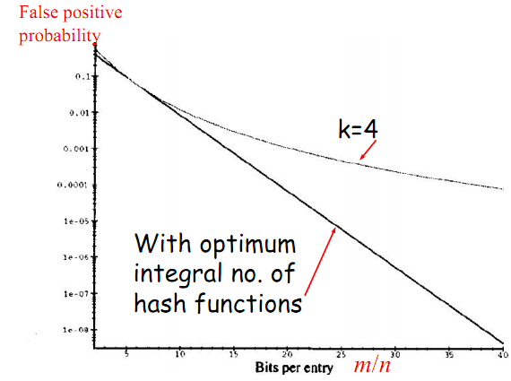
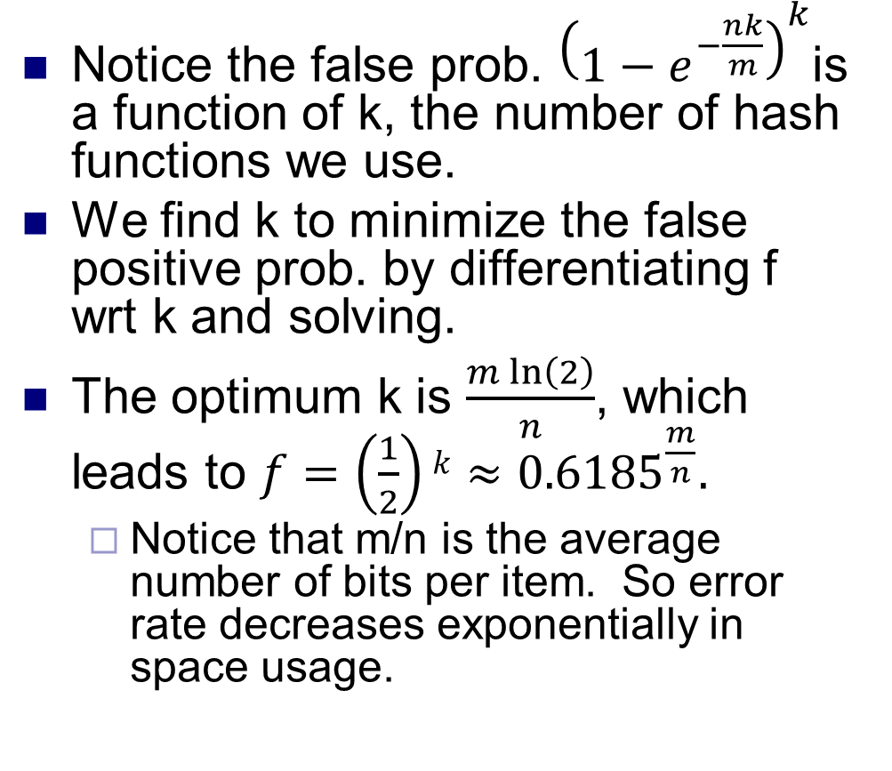
False positive probability 3
Notice the false prob. ${\left(1−e^{−\frac{nk}{m}}\right)}^{k}$is a function of k, the number of hash functions we use.
We find k to minimize the false positive prob. by differentiating f wrt k and solving.
The optimum k is $\frac{m ln\left(2\right)}{n}$, which leads to $f=\left(\frac{1}{2}\right)k≈{0.6185}^{\frac{m}{n}}.$
Notice that m/n is the average number of bits per item. So error rate decreases exponentially in space usage.

Slide 10
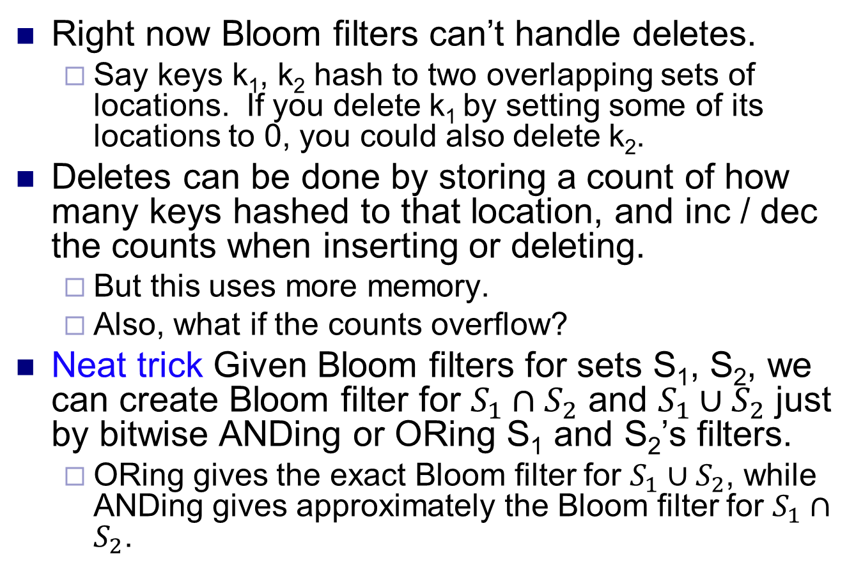
Improvements
Right now Bloom filters can’t handle deletes.
Say keys k₁, k₂ hash to two overlapping sets of locations. If you delete k₁ by setting some of its locations to 0, you could also delete k₂.
Deletes can be done by storing a count of how many keys hashed to that location, and inc / dec the counts when inserting or deleting.
But this uses more memory.
Also, what if the counts overflow?
Neat trick Given Bloom filters for sets S₁, S₂, we can create Bloom filter for $S_{1}∩S_{2}$ and $S_{1}∪S_{2}$ just by bitwise ANDing or ORing S₁ and S₂’s filters.
ORing gives the exact Bloom filter for $S_{1}∪S_{2}$, while ANDing gives approximately the Bloom filter for $S_{1}∩S_{2}$.

Slide 11


String equality and fingerprinting
Alice and Bob both have copies of a database.
They want to keep the database consistent, so they want to check if their copies are the same.
If you think of the databases as strings, they want to check if their strings are equal.
But transferring the entire database is expensive.
Instead, they calculate a small value called a fingerprint of their databases.
If the fingerprints are the different, then their databases are definitely different.
If the fingerprints are the same, then the databases are probably the same; but there’s a small probability they’re actually different.
Transferring the fingerprint is much cheaper than the database.

Slide 12
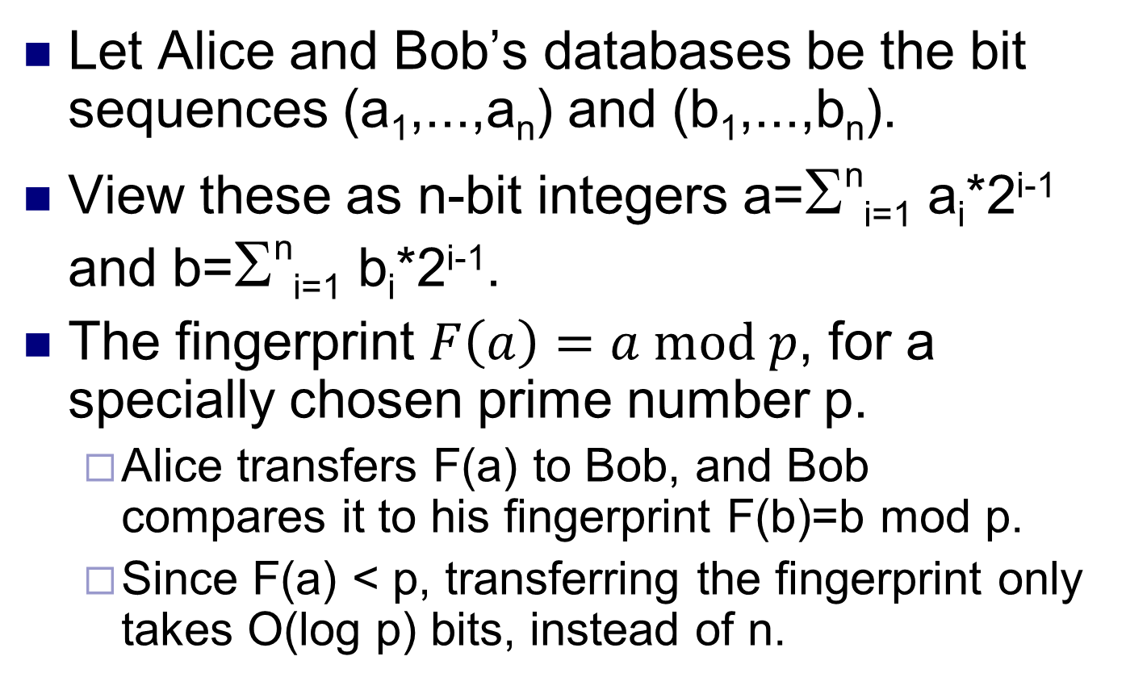
Fingerprinting
Let Alice and Bob’s databases be the bit sequences (a₁,...,a_{n}) and (b₁,...,b_{n}).
View these as n-bit integers a=Σ^{n}_{i=1} a_{i}*2^{i-1} and b=Σ^{n}_{i=1} b_{i}*2^{i-1}.
The fingerprint $F\left(a\right)=a mod p$, for a specially chosen prime number p.
Alice transfers F(a) to Bob, and Bob compares it to his fingerprint F(b)=b mod p.
Since F(a) < p, transferring the fingerprint only takes O(log p) bits, instead of n.

Slide 13
Correctness
No false negatives.
If F(a)≠F(b), then a≠b.
False positives are possible.
If F(a)=F(b), then a mod p = b mod p.
So either a=b, or a≠b but p divides (a-b).
We can’t avoid false positives. But we can minimize the probability it occurs.
Pick a random p.
If a≠b, then probably p doesn’t divide (a-b), so probably F(a)≠F(b) and we’ll detect a and b are different.
Bigger p decreases false positives probability.
But we don’t want to make p too big, since we have to transfer O(log p) bits.

Slide 14
Correctness
To analyze the false positives probability, we use two facts from number theory.
Lemma Any number t has at most log₂(t) distinct prime divisors.
Proof Each divisor is ≥ 2, and their product is ≤ t. If there were more than log₂(t) divisors, their product would be > 2^{log2(t)} =t, contradiction.
Recall a=Σ^{n}_{i=1} a_{i}*2^{i-1} and b=Σ^{n}_{i=1} b_{i}*2^{i-1}.
So a-b<2^{n}, and so a-b has at most n distinct prime divisors.

Slide 15
Correctness
Prime Number Theorem Given any number t, the number of primes smaller than t is ~ t / ln(t).
The PNT allows us to efficiently generate a random prime.
Picking a number less than t at random, it has a 1/ln(t) probability of being prime.
We can check if a number is prime using the Rabin-Miller primality test.
If number is prime, it always passes the test.
If number is composite, there’s small probability it’s declared a prime.
Run the test few more times to exponentially decrease false positive probability.
So with high probability, we can tell if a number is prime.

Slide 16
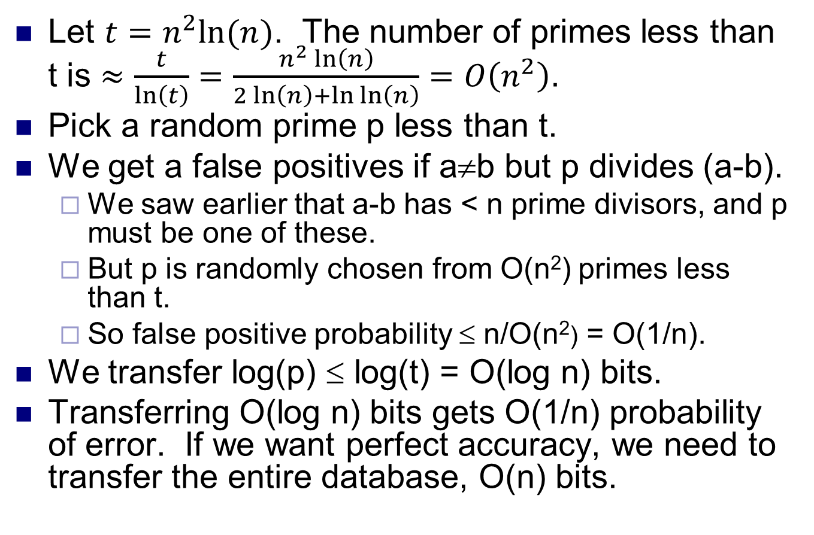
Correctness
Let $t=n^{2}ln⁡(n)$. The number of primes less than t is $≈\frac{t}{\ln\left(t\right)}=\frac{n^{2}\ln\left(n\right)}{2\ln\left(n\right)+\ln{\ln\left(n\right)}}=O\left(n^{2}\right)$.
Pick a random prime p less than t.
We get a false positives if a≠b but p divides (a-b).
We saw earlier that a-b has < n prime divisors, and p must be one of these.
But p is randomly chosen from O(n²) primes less than t.
So false positive probability ≤ n/O(n²) = O(1/n).
We transfer log(p) ≤ log(t) = O(log n) bits.
Transferring O(log n) bits gets O(1/n) probability of error. If we want perfect accuracy, we need to transfer the entire database, O(n) bits.

Slide 17
String matching
In the previous problem, we checked whether two strings are equal.
We now want to see if one string X contains the other Y. I.e. we want to match Y to a part of X.
Let X and Y be binary strings with length n and m, resp., where n≥m.
We’ll look at a simple randomized O(n+m) time string matching algorithm Rabin-Karp.
X 1 0 0 1 1 1 0 1 0 0 1 0 0 0 0 1
Y 1 1 1 0 1 0

Slide 18
String matching
Let X=x₁x₂...x_{n}, and define X(j)=x_{j}x_{j+1}...x_{j+m-1}.
X(j) has the same length as Y.
It represents a potential match for Y starting at the j’th bit of X.
Y matches X if there exists 1≤j≤n-m+1 s.t. X(j)=Y.
We just saw a way to test string equality using fingerprints.
We first give a O(n+m) time Monte Carlo string matching algorithm.
There’s small probability it says Y matches X even when it doesn’t.
Then we convert it to an expected O(n+m) time Las Vegas algorithm, which always gives correct answer.
X(4)
X 1 0 0 1 1 1 0 1 0 0 1 0 0 0 0 1
Y 1 1 1 0 1 0

Slide 19
Monte Carlo string matching
Choose a random prime p.
We’ll determine how big p should be later.
For every 1≤j≤n-m+1.
View X(j) and Y as m-bit numbers.
Compute F(X(j))=X(j) mod p and F(Y)=Y mod p.
If F(X(j))≠F(Y), go to next j.
If F(X(j))=F(Y), output “Y matches X at bit j”.
Output “Y doesn’t match X”.

Slide 20
Correctness
Consider X(j) and Y, for some j.
If F(X(j))≠F(Y), then X(j)≠Y and there’s no match at X’s j’th bit.
So no false negatives.
If F(X(j))=F(Y), then either X(j)=Y, or X(j)≠Y but p divides X(j)-Y.
So there could be false positives.
Let’s bound this probability.
X(j)-Y is an m-bit number, so by the lemma, it has ≤ m distinct prime factors.
Let t=n²m log(n²m), and let p be a random prime ≤ t.
There are ~ n²m primes ≤ t, by the PNT.

Slide 21
Correctness
We only get a false positive if p is one of the ≤ m factors of X(j)-Y.
So we get a false match between X(j) and Y with probability ≤ m/n²m = 1/n².
Now, we falsely match X to Y if there is any 1≤j≤n-m+1 s.t. X(j)≠Y but F(X(j))=F(Y).
For each j, this event has probability ≤ 1/n².
So the probability this happens at any of the n-m+1 j’s is ≤ (n-m+1)/n² = O(1/n).
This is called the union bound.
If Pr[E_{i}]=p_{i} for 1≤i≤k , then Pr[E₁∪...∪E_{k}]≤p₁+...+p_{n}.
Putting it together, if Y matches X somewhere, then this algorithm finds the match. If Y doesn’t match X, this algorithm says Y matches X with probability O(1/n).

Slide 22
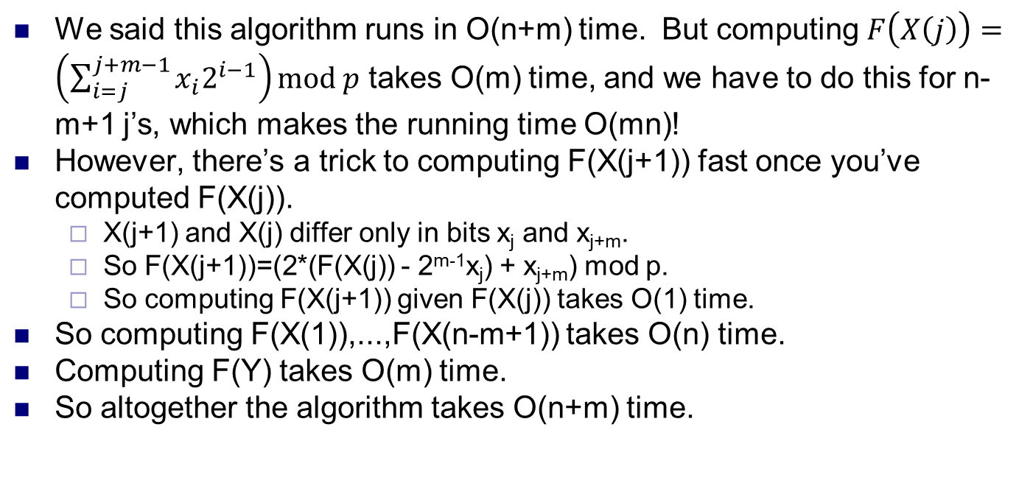
Running time
We said this algorithm runs in O(n+m) time. But computing $F\left(X\left(j\right)\right)=\left(\sum_{i=j}^{j+m−1}{x_{i}2^{i−1}}\right)mod p$ takes O(m) time, and we have to do this for n-m+1 j’s, which makes the running time O(mn)!
However, there’s a trick to computing F(X(j+1)) fast once you’ve computed F(X(j)).
X(j+1) and X(j) differ only in bits x_{j} and x_{j+m}.
So F(X(j+1))=(2*(F(X(j)) - 2^{m-1}x_{j}) + x_{j+m}) mod p.
So computing F(X(j+1)) given F(X(j)) takes O(1) time.
So computing F(X(1)),...,F(X(n-m+1)) takes O(n) time.
Computing F(Y) takes O(m) time.
So altogether the algorithm takes O(n+m) time.
x_{j} x_{j+1} . . . x_{j+m-1} x_{j+m}

Slide 23
A Las Vegas algorithm
We now modify the previous algorithm so it always produces the right answer.
Run the Monte Carlo algorithm.
If it never produces a match, output “Y doesn’t match X”.
If it ever outputs a match, say between X(j) and Y, then check X(j)=Y in O(m) time.
If X(j)=Y, output “Y matches X at bit j”.
If X(j)≠Y, start over and run the brute force O(mn) time to match Y to X.

Slide 24
Correctness
Since the Monte Carlo algorithm only produced false positives and this algorithm checks them using brute force, it always produces the right answer.
The expected running time is Pr[no false positives]*(running time if no false positives)+Pr[there is false positive]*(running time when there’s false positive).
The first term is O(n+m).
The second term is ≤ 1/n*O(mn)=O(m).
So the total expected running time is O(n+m).

